Slide 1
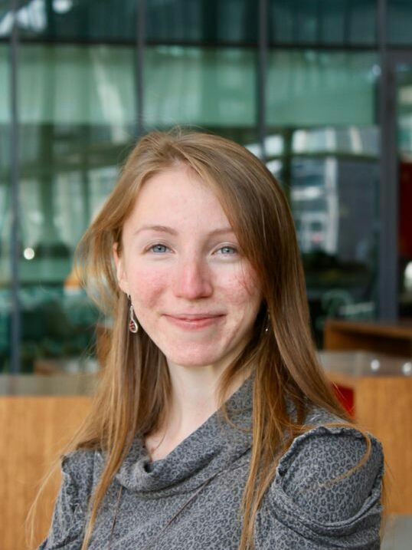
Bio-ortogonal catalysis for cancer therapy
Rodica Alis Olea
ESR7 Fellow
Institution: Institute for Bioengineering of Catalonia (IBEC)
Group: Nanoscopy for nanomedicine
Supervisor: Lorenzo Albertazzi
E-mail: aolea@ibecbarcelona.eu
Mid-Term Check Meeting
Edinburgh, 5th June 2019

Slide 2
Personal trajectory

Slide 3
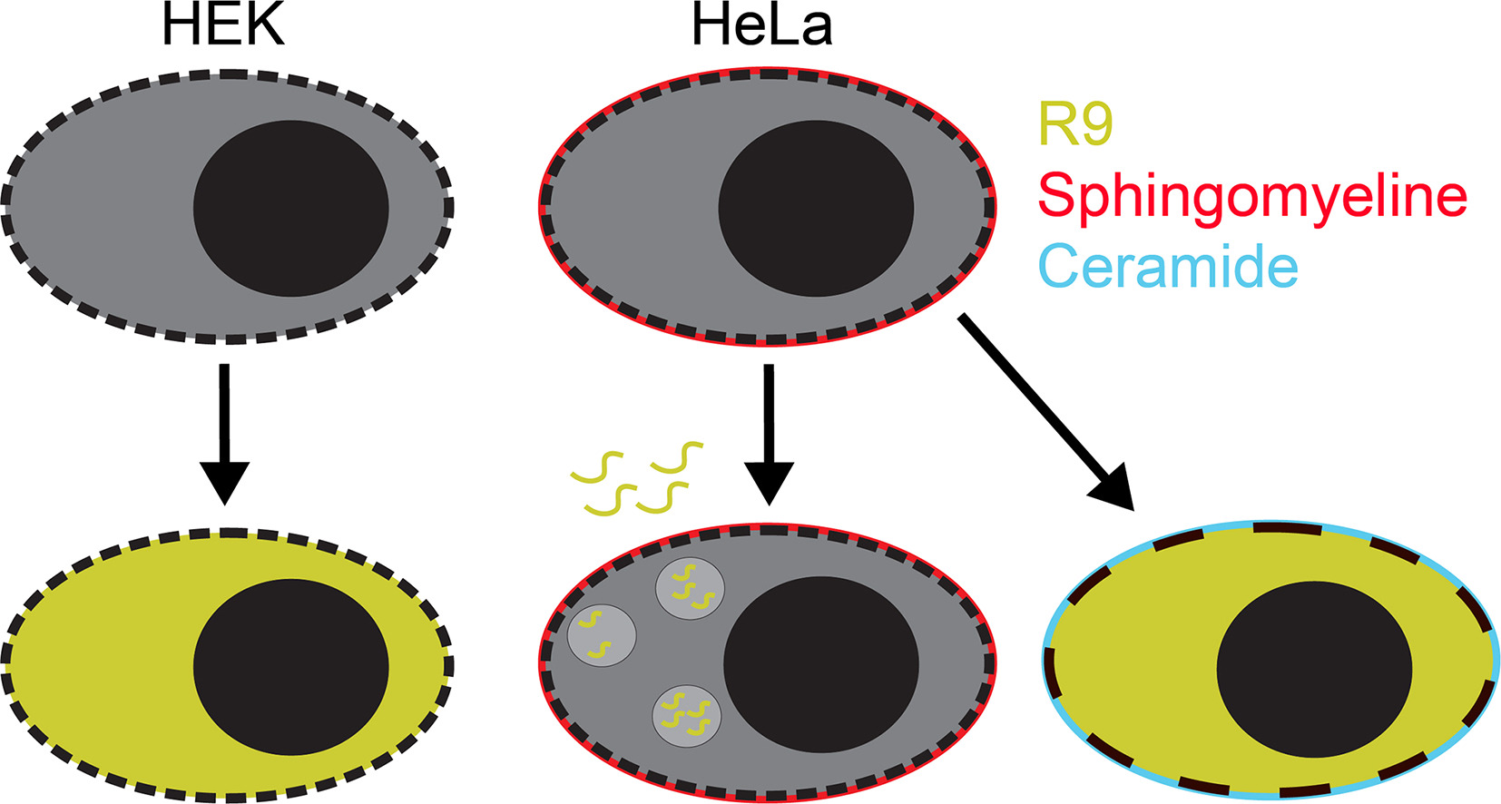
1st internship in Radboud University Medical Center
Background and skills
Supervisor: Prof. Roland Brock, Dept. of Biochemistry of Integrated Systems
The uptake mechanism of cell penetrating peptides
Confocal microscopy techniques
J. of Controlled Release, 2017

Slide 4
2nd internship in IBEC, Barcelona
Background and skills
Super-resolution microscopy on complexes of cell penetrating peptides (R9) and genetic cargo (mRNA)
Supervisor: Dr. Lorenzo Albertazzi, Nanoscopy for nanomedicine group
Nanoletters, 2019

Slide 5
Background and skills
TIRF
Alexa488-R9
Cy5-mRNA
2 µm
Nanoletters, 2019

Slide 6
Background and skills
STORM
Alexa488-R9
Cy5-mRNA
2 µm
Nanoletters, 2019
Nanoletters, 2019

Slide 7
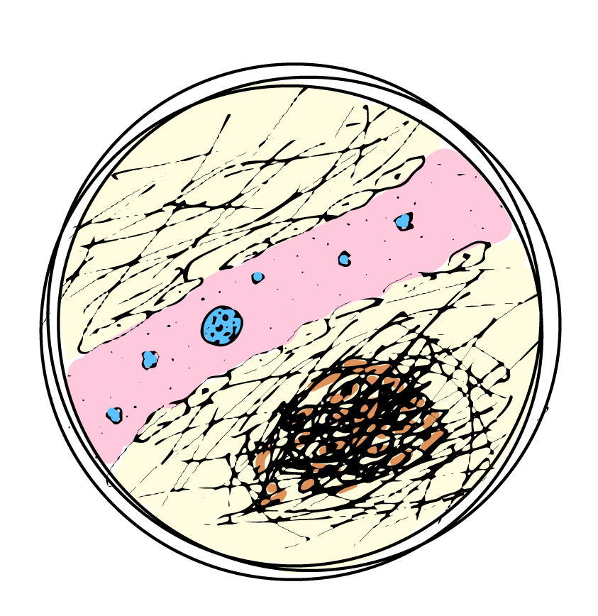
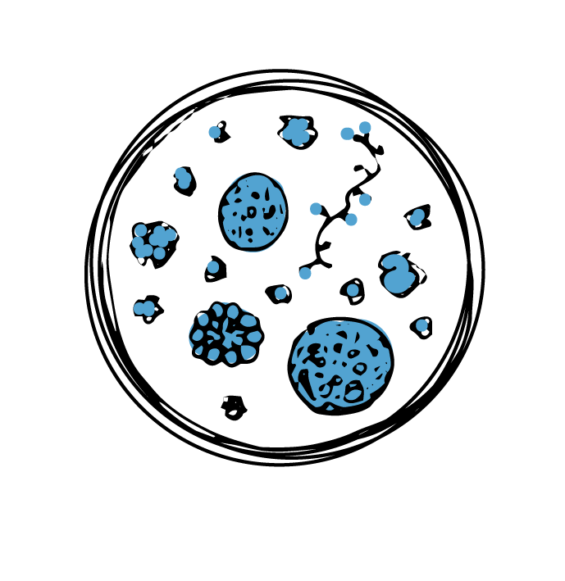
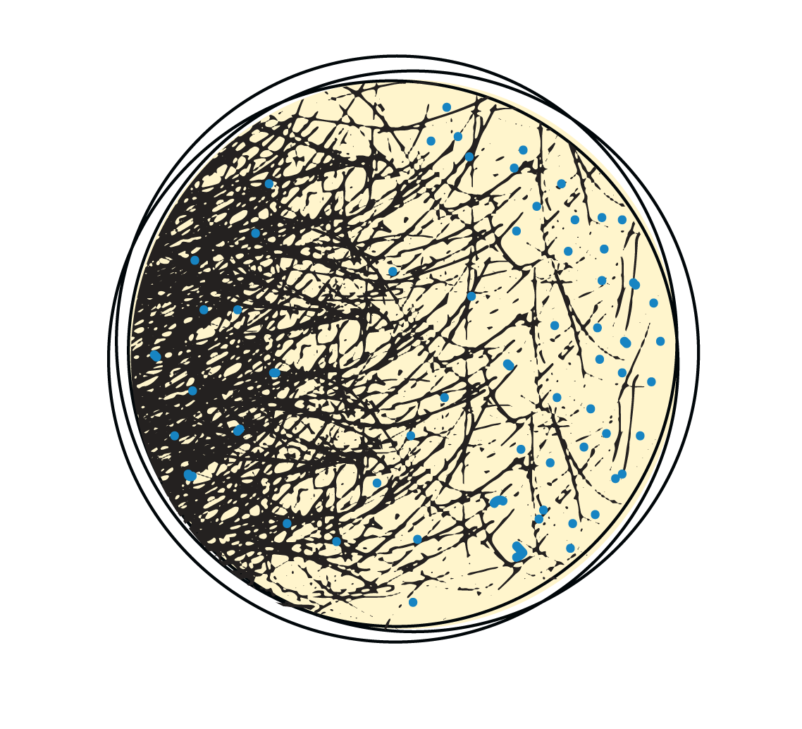
Research project
Objectives
Develop a method for STORM nanocatalyst imaging
Imaging the localization and amount of nanocatalyst in different models
STORM imaging of prodye activation in different models

Slide 8
Research project
Objectives
Develop a method for STORM nanocatalyst imaging
Imaging the localization and amount of nanocatalyst in different models
STORM imaging of prodye activation in different models
Foreseen research
Optimize model of extracellular matrix for imaging of drug delivery, based on Biogelx hydrogels
Combine the ECM model with cell cultures of cancer cells and co-cultures with other cell types (endothelial, fibroblasts) – 3D models
Test the penetration of nanocatalysts in the cancer models
Test the local catalysis in both in vitro and in situ models

Slide 9
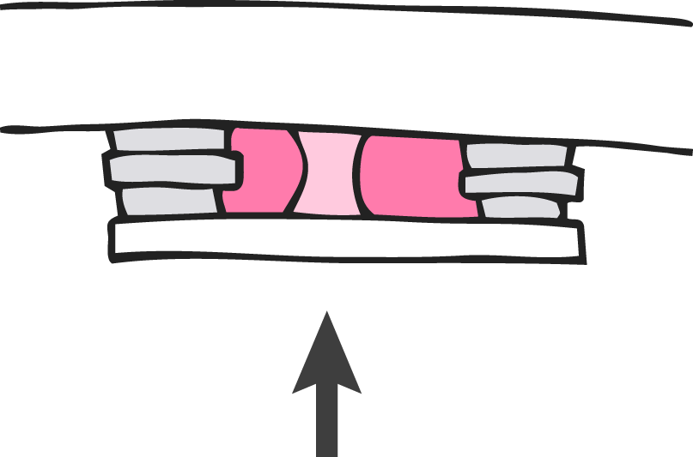
Research project
Preliminary Results: possible model of Biogelx ¨gel column¨
glass slide
gel
sticky tape
Medium
(+ nanoparticles)
cover slip
optical path

Slide 10
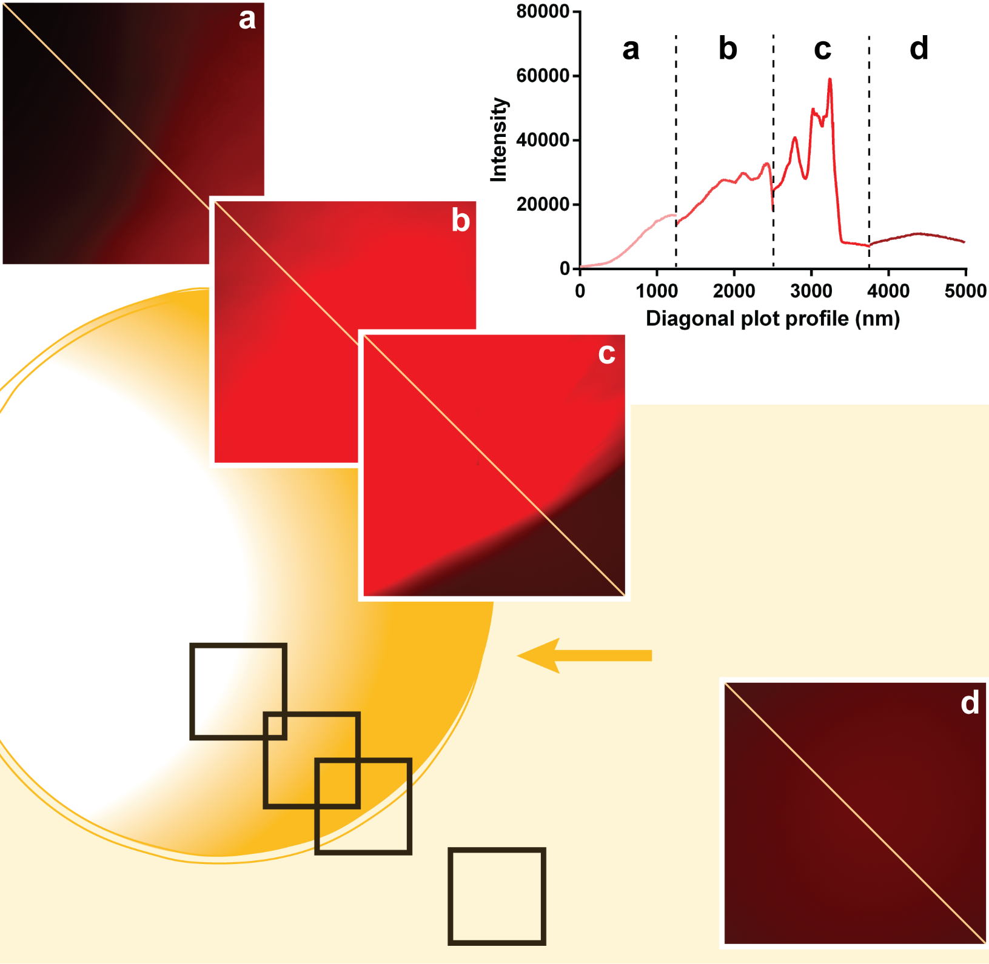
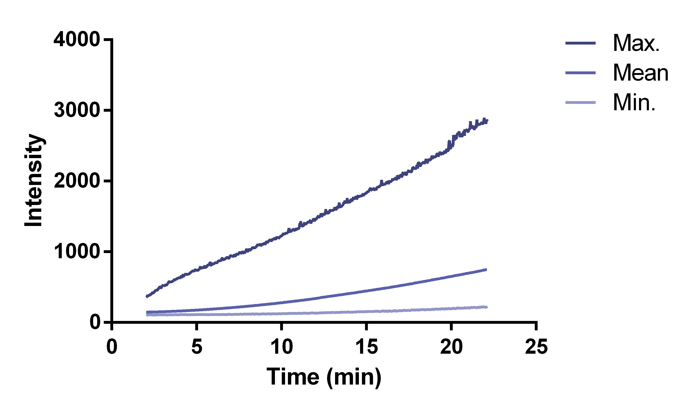
Research project
Preliminary Results: possible model of Biogelx ¨gel column¨
Measuring diffusion of
dextran-AlexaFluor568
through Biogelx gel
e
e

Slide 11
Secondments
Secondment 1
Institution and sector: Biogelx Limited (BGX), non-academic
Duration: 3 months, starting from M21 (November 2019)
Main research objectives: Imaging gel models
New knowledge and competences expected to be acquired:
knowledge on manufacture of gels & ways of imaging porous structures in high resolution,
information on the localization of the catalyst in 2D and 3D cell cultures
Secondment 2
Institution and sector: Tel Aviv University (TAU), academic
Duration: 4 months, starting from M30 (August 2020)
Main research objectives: In vivo and ex-vivo imaging of catalysis
New knowledge and competences expected to be acquired:
sample preparation tailored to 3D tissues for high resolution imaging,
knowledge on the localization and function of the catalyst inside living organisms

Slide 12
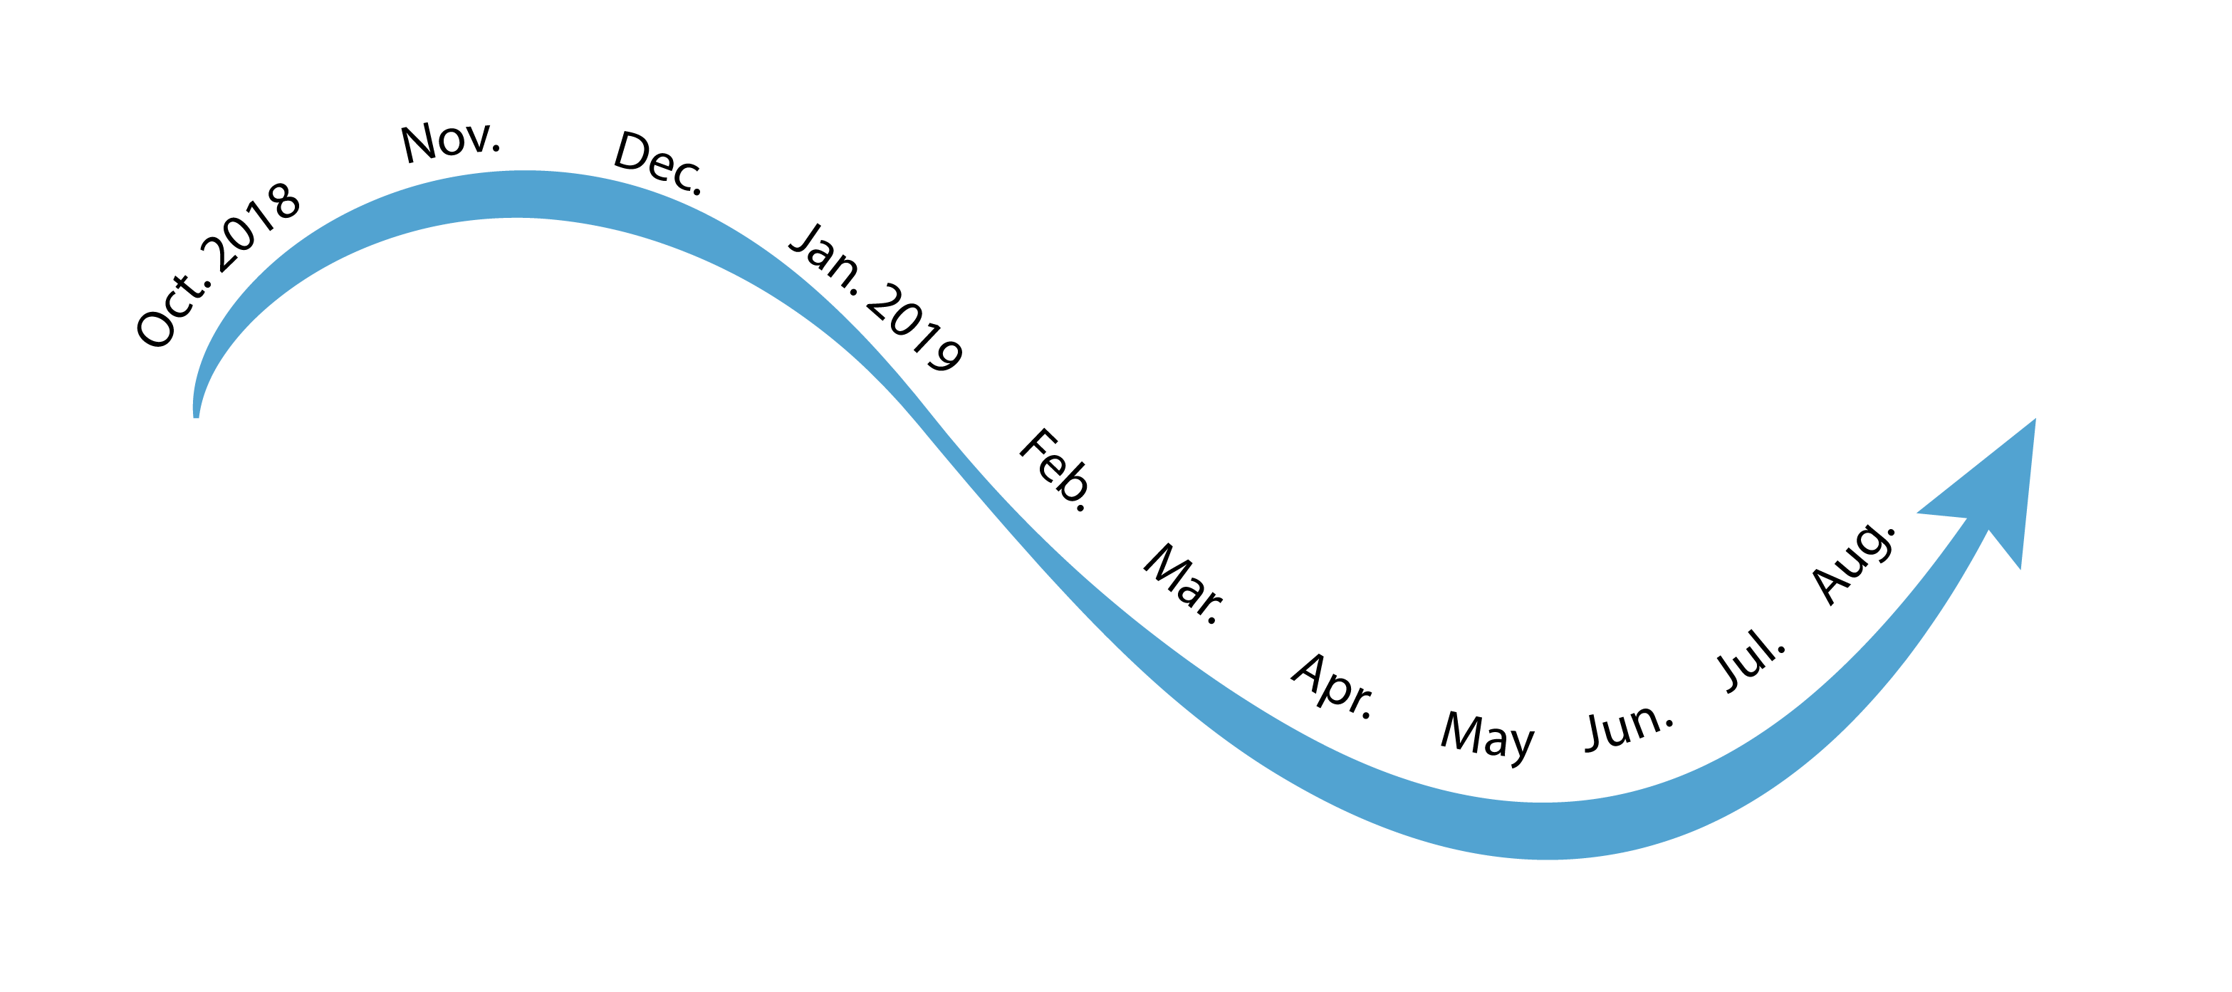
Scientific and Transversal Skills Training
Local training
Oct 2 – 11th IBEC Symposium
Feb. 8 – BIST Symposium on Microscopy, Nanoscopy and Imaging Sciences
Mar. 7 – 9th CNAG Symposium on 3D genomics
Workshop on Chemometrics & Experiment Design
Jul. 17 – 12th IBEC Symposium
General laboratory &
Cell culture training
Trainings for different in-house microscopes (Nikon eclipse Ti2 and Zeiss confocal LSM 800)
Workshop on Entrepreneurship
Workshop on Fiji ImageJ analysis

Slide 13
Scientific and Transversal Skills Training
Network-wide training
6-7/06.2019 Edinburgh
Bioorthogonal & Bioresponsive
25-29/03/2019
Eindhoven (TUE)
Meeting 1 & Training Event 1: How to Plan and Start a PhD
23-27/09/2019
Basel (BAS)
Training Event 2: Chemical Synthesis and Catalysis
Edinburgh (EDI)
Meeting 2 & Training Event 3: Dug Delivery and microscopy
Barcelona (IBEC)
Meeting 3 & Training Event 5: Getting ready for the next career step
Tel Aviv (TAU)
Training Event 4: Going in vivo, chemistry and cancer biology
PhD studies
University: University of Barcelona
Title of PhD: Super-Resolution Imaging of Bioorthogonal Catalytic Nanoparticles
for Cancer Therapy
Enrolment: 16/10/2018

