Slide 1
Institution Logo
Bio-ortogonal catalysis for cancer therapy
Stephen Croke
ESR5 Fellow
Institution: University of Edinburgh
Group: BOOM Chemistry @BOOMchemistry
Supervisor: Prof. Asier Unciti-Broceta
E-mail: scroke@ed.ac.uk
Mid-Term Check Meeting
Edinburgh, 5th June 2019

Slide 2
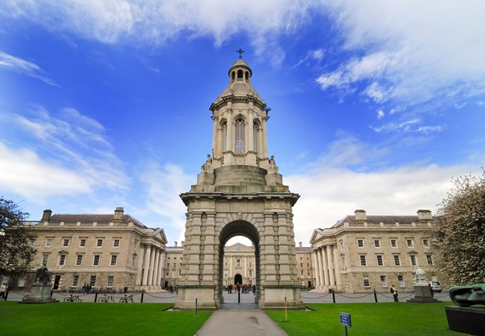
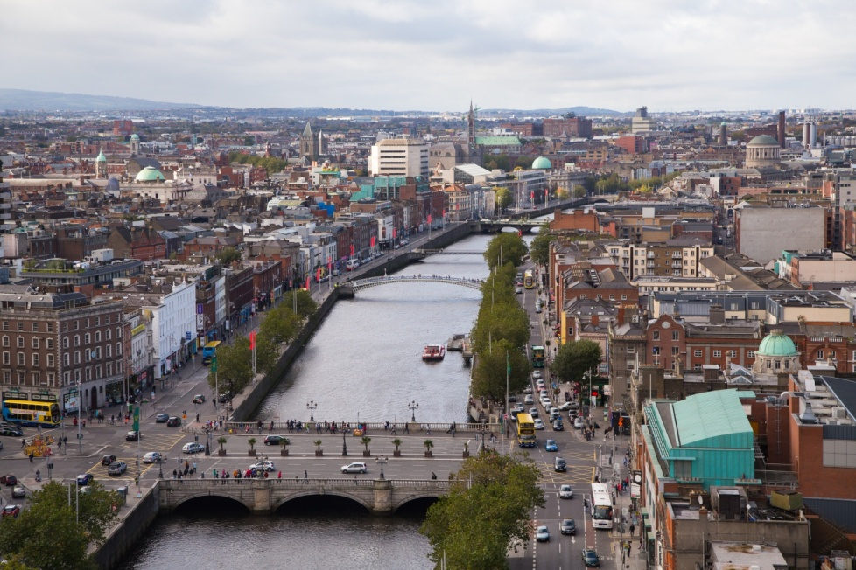
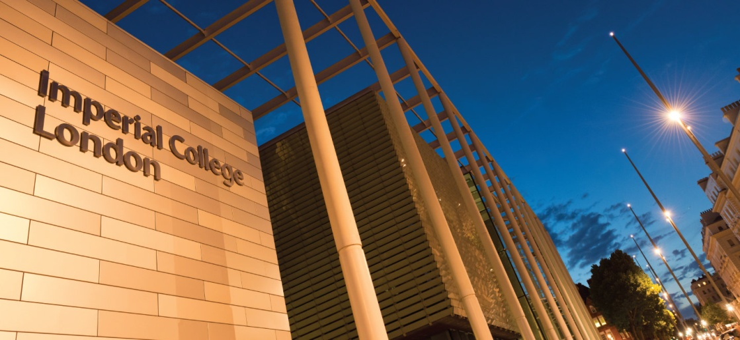
Insttution Logo
Personal trajectory

Slide 3
Institution Logo
Background and skills
Organic Synthesis
Fluorescent probes
Oligonucleoside
Peptide synthesis
Biology
Assay development
Fluorescent Imaging
SAR studies
Drug design
Analytical Chemistry
Method development
UPLC-MS
NMR characterisation
Prep-HPLC

Slide 4
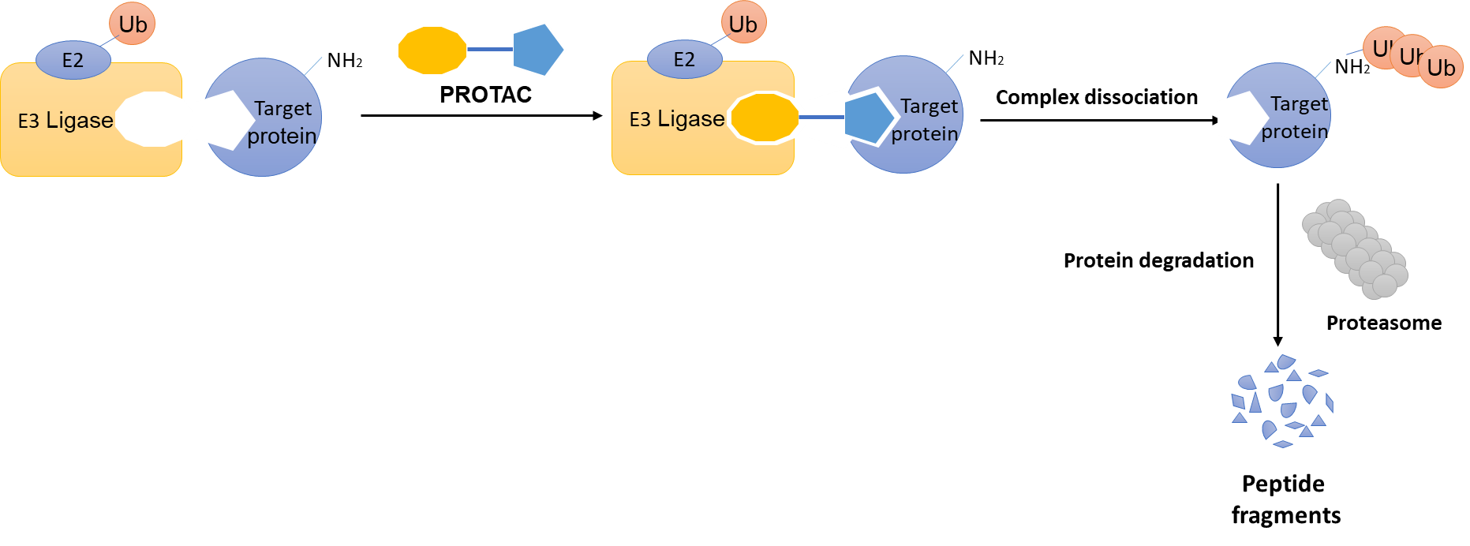
Institution Logo
Research project
Developing bioorthogonal approaches for PROtein TArgetting Chimera (PROTAC)
Ligand for E3 ligase
Warhead for target protein
Linker

Slide 5
Institution Logo
Research project
In vivo PROTAC assembly for targeted protein degradation
Dasatinib
(ligand of oncoproteins BCR-ABL and SRC)
Cereblon
(E3 ligase ligand)
“click” assembled PROTAC

Slide 6
Institution Logo
Research project
Objectives
Synthesis library of Cu assembled PROTACs
Investigate reaction kinetics of Cu-mediated PROTAC synthesis ranked
PROTAC assembly study in cell culture
✓
Foreseen research
Organic synthesis
Assay development
Proteomics
Kinetic studies

Slide 7
Institution Logo
Secondments
Secondment 1
Institution and sector: Tagworks Pharmaceuticals, industrial
Duration: 4 months
Main research objectives: Imaging studies, protein functionalization and in vivo studies
New knowledge and competences expected to be acquired: Protein chemistry, animal models, in vivo imaging, industrial R&D experience
Secondment 2
Institution and sector: Tel Aviv University, academic
Duration: 3 months
Main research objectives: Test micelles catalysts
New knowledge and competences expected to be acquired: Polymer chemistry, kinetic studies

Slide 8
Institution Logo
Scientific and Transversal Skills Training
Local training
B&B Symposium
NP synthesis training
Cell-based assay training
3 minute thesis
Tissue culture training
Nov
April
May
June
May
2019
2020
Chemical biology symposium
Western blot training

Slide 9
Institution Logo
Scientific and Transversal Skills Training
Network wide training
TAU
M30
IBEC
M36
TUE
25-29th/05/19
UoE
M24
Basel
23-27th/09/19
How to plan & start a PhD
Chemical synthesis & catalysis
Drug delivery & microscopy
Going in vivo, chemistry and cancer biology
Getting ready for next career step
PhD studies
University: University of Edinburgh
Title of PhD: PhD in Molecular Medicine
Enrolment: 10/11/2018

Slide 10
Institution Logo
Bio-ortogonal catalysis for cancer therapy
Thank you for listening

