Slide 1
Bio-orthogonal catalysis for cancer therapy
Shreyas Wagle
ESR 2 Fellow
Institution: Tel Aviv University
Group: Organic & Polymer chemistry
Supervisor: Prof. Roey J. Amir
E-mail: wagle@tauex.tau.ac.il
Mid-Term Check Meeting
Edinburgh, 5th June 2019

Slide 2
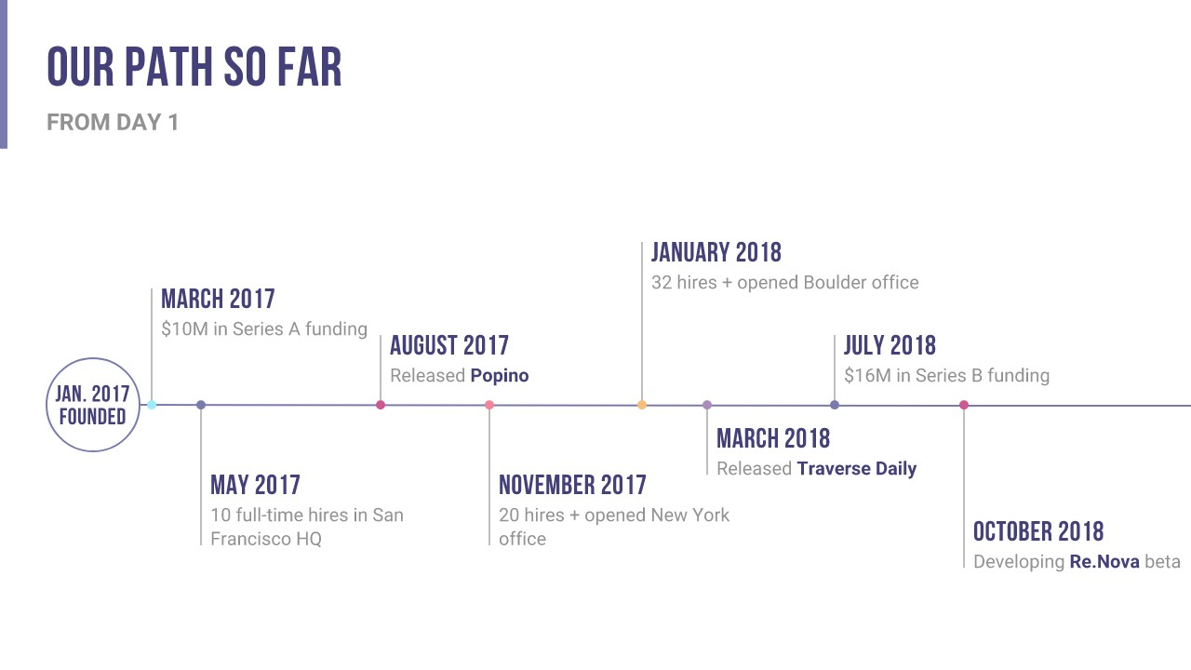
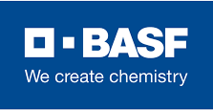
Personal Trajectory
M.Sc. Polymer Material Sciences
Polymer Chemistry
Polymer Physics
B.Tech Textile Chemistry
Fibre Sciences
Organic chemistry
Internship at BASF(India)
Pigment Printing
Stretchable Prints
M.Sc. Master Thesis
Optical damage sensing and self-healing system
Research Project
Synthesis of self-healing probes
Encapsulation of the chemical probes
Internship at Vishnu Dyeing and Printing
Pre-treatment Layout
Dyeing & Printing layout
Bachelor Thesis
Synthesizing nanocellulose
Superabsorbent Films
PhD Micellar Catalysts
Design & synthesis of multi-functional polymeric amphiphiles.
Catalytic activation of anti-cancer prodrugs.

Slide 3
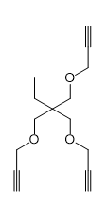
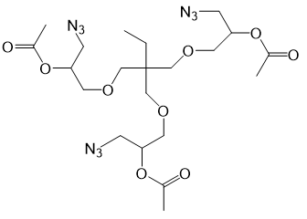
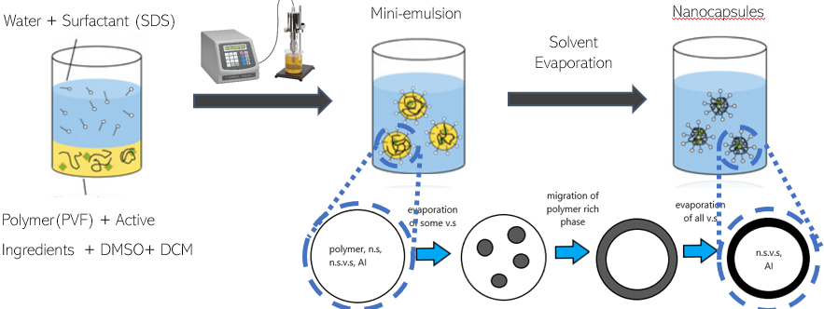
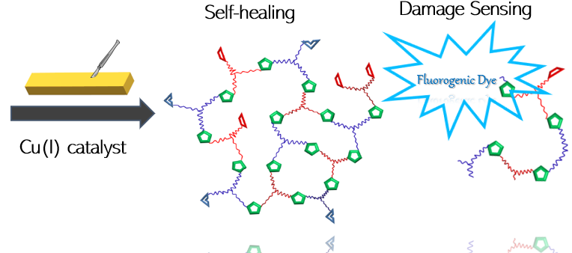
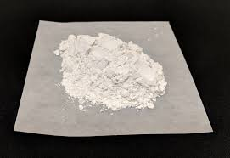
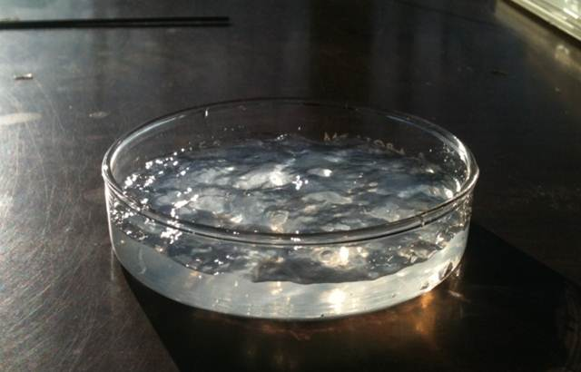
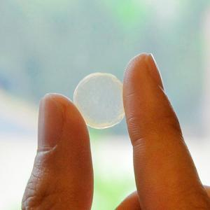
Background & skills
Martin Luther University, Halle (Saale), (Germany)
Polymer Chemistry,
Organic Synthesis
Fluorogenic Probes
Institute of Chemical Technology, Mumbai (India)
Textile Chemistry
Fibre Sciences

Slide 4
Research project
Objectives
Develop block-copolymer amphiphiles bearing mono or bivalent ligands
Metal complexation and self-assembly of micelles
Characterization of Structure activity relationship of (nano)catalysts and its optimization
Foreseen research
Amphiphilic block copolymers with mono/bivalent ligands
Catalysis experiments
Structure Activity studies & formulation optimization

Slide 5
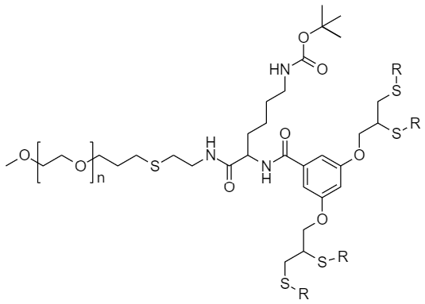
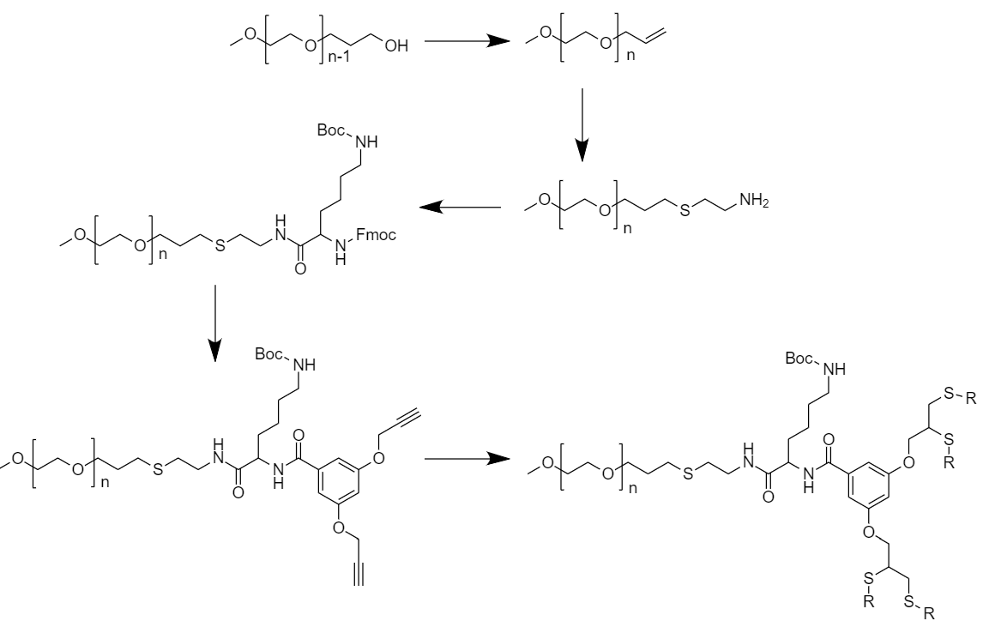
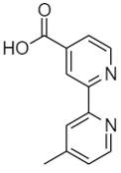
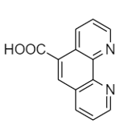
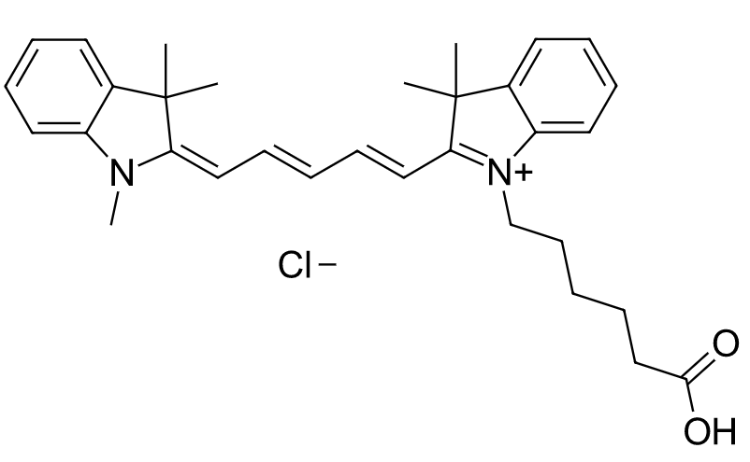
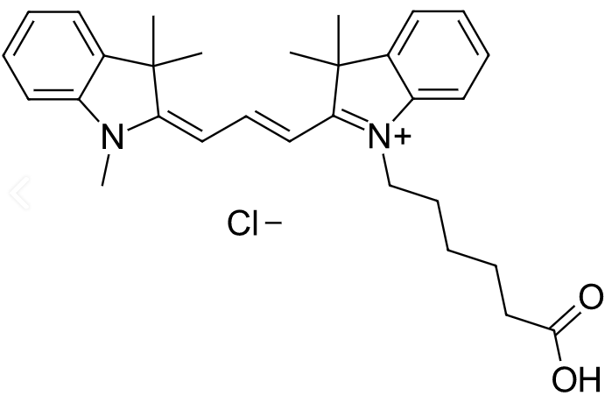
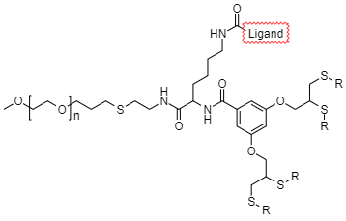
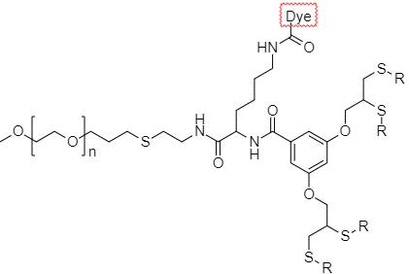
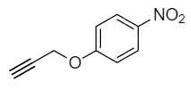
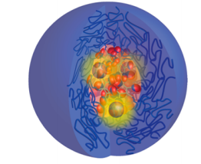
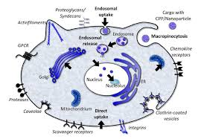
Scheme
R = Alkyl chain (length= 6,7,8,12)
Cell internalization studies

Slide 6
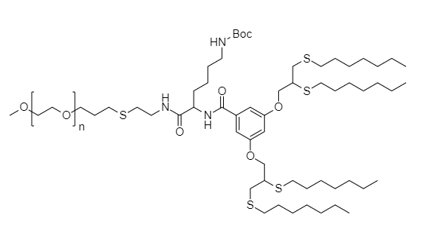
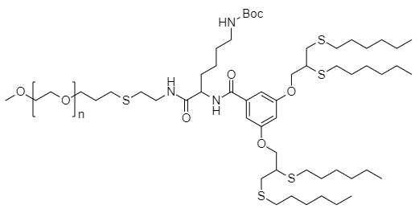
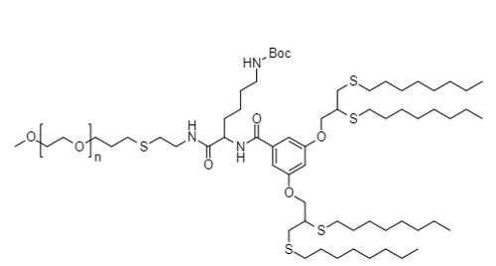
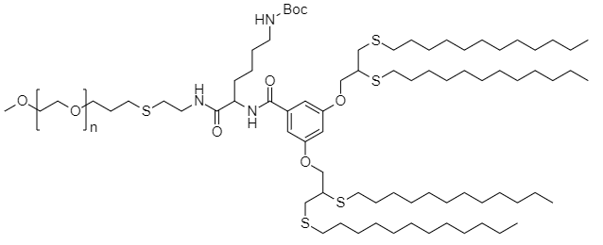
Preliminary Results
PEG-C6 Hybrid
PEG-C7 Hybrid
Tests | Measurements
GPC | 1.054
DLS | 20 ± 3.0 nm
CMC | 4±2 µM
Tests | Measurements
GPC | 1.034
DLS | 24 ± 1 nm
CMC | 4±2 µM
PEG-C12 Hybrid
PEG-C8 Hybrid
Tests | Measurements
GPC | 1.039
DLS | 32 ± 6 nm
CMC | 3±1 µM
Tests | Measurements
GPC | 1.044
DLS | 30 ± 3 nm
CMC | 4±1 µM

Slide 7
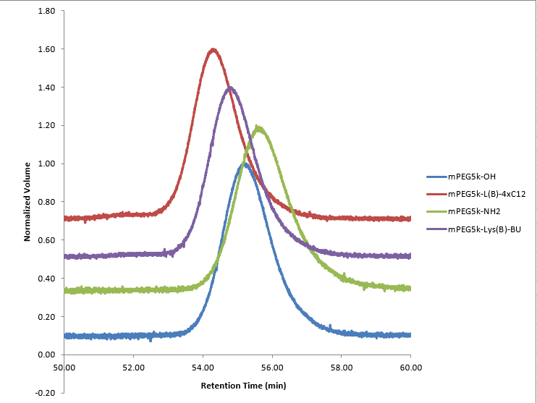
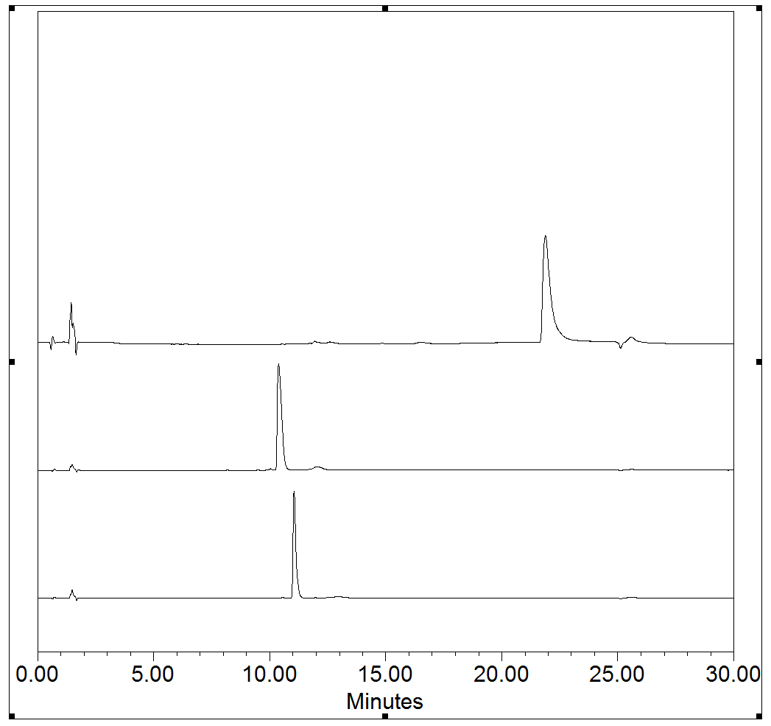
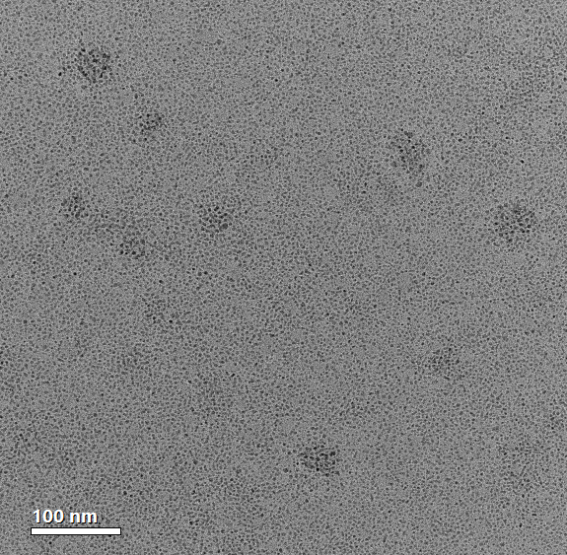
Preliminary Results
Sample | PDI
mPEG_{5k}-OH | 1.036
mPEG_{5k}-NH₂ | 1.051
mPEG_{5k}-Lys(B)-BU | 1.040
mPEG_{5k}-L(B)-4xC12 | 1.039
mPEG-Lys(Boc)-4xC12
mPEG-Lys(Boc)-BU
mPEG-Lys(Boc)-fmoc
32 ± 6 nm

Slide 8
Secondments
Secondment 1
Institution and sector: Stratingh Institute for Chemistry, Rijksuniversiteit Groningen (Academic)
Duration: 3 months
Main research objectives: Metal catalyst synthesis
New knowledge and competences expected to be acquired: Organometallic Chemistry, Catalyst Synthesis, structure characterization, catalysis performance and profile.
Secondment 2
Institution and sector: Tagworks Pharmaceuticals BV (Non-academic)
Duration: 4 months
Main research objectives: In-vivo micelle imaging
New knowledge and competences expected to be acquired: In vivo chemistry, Radioimmunoimaging, PET imaging, Start-up development

Slide 9
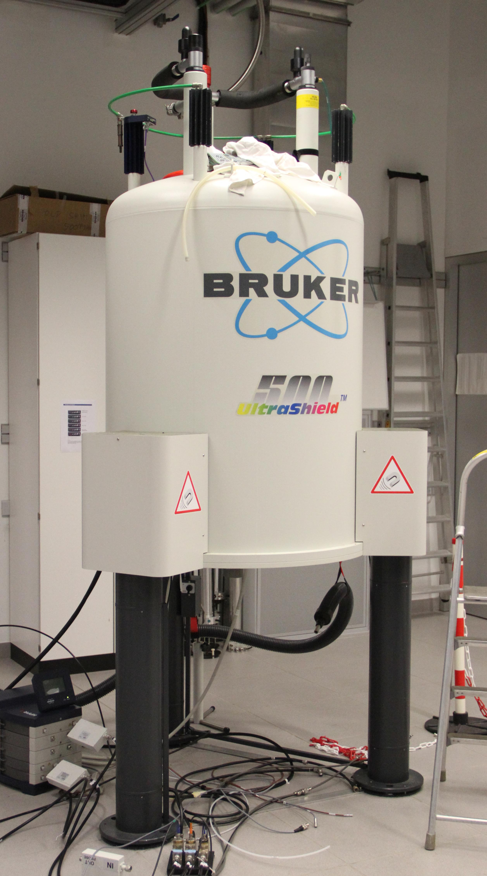
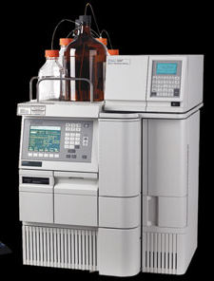
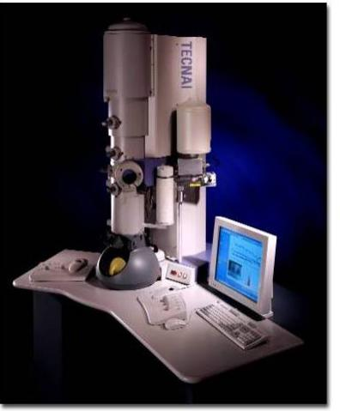
Scientific and Transversal Skills Training
Local training
Synthesis & characterization of micelles
ICS 2019
Exploring metal catalysis
New cancer treatment pathways
Synthesis & characterization of ligands and their complexes
Courses
Chemistry of Sugars
Methods & tools in chemical Biology
Preliminary Catalysis
Using polymer encapsulated complex for catalysis
NMR
HPLC
TEM

Slide 10
Scientific and Transversal Skills Training
Network-wide training
Secondment at RUG
(Early 2020)
Catalyst Synthesis
Catalyst performance & profile
Training event at TU/e (03/‘19)
Introduction to programme
Scientific communication
Training event at Tel Aviv (2021)
in vivo imaging
In vivo chemistry and cancer biology
ICCA conference(09/’19)
Catalysis and Chemical Engineering
MTC Meeting(06/‘19) & Bioorthogonal & Bioresponsive 2019
Discussion with Project officer
Bio-orthogonal chemistry symposium
Training event at Edinburgh(2020)
Designing delivery systems
in-vitro imaging and cell assays
Training event at Basel (09/’19)
Chemical synthesis & catalysis
Prodrugs: design principles, synthesis
Training event at Barcelona (2021)
Career opportunities in industry and interview simulations
Innovation and Entrepreneurship
PhD studies
University: Tel Aviv University, Israel.
Title of PhD: Micellar catalysts
Enrolment: 21/11/2018

