Slide 1
Bio-orthogonal Catalysis for Cancer Therapy
Biogelx Presentation
Mid-Term Check Meeting
Edinburgh, 5th June 2019

Slide 2
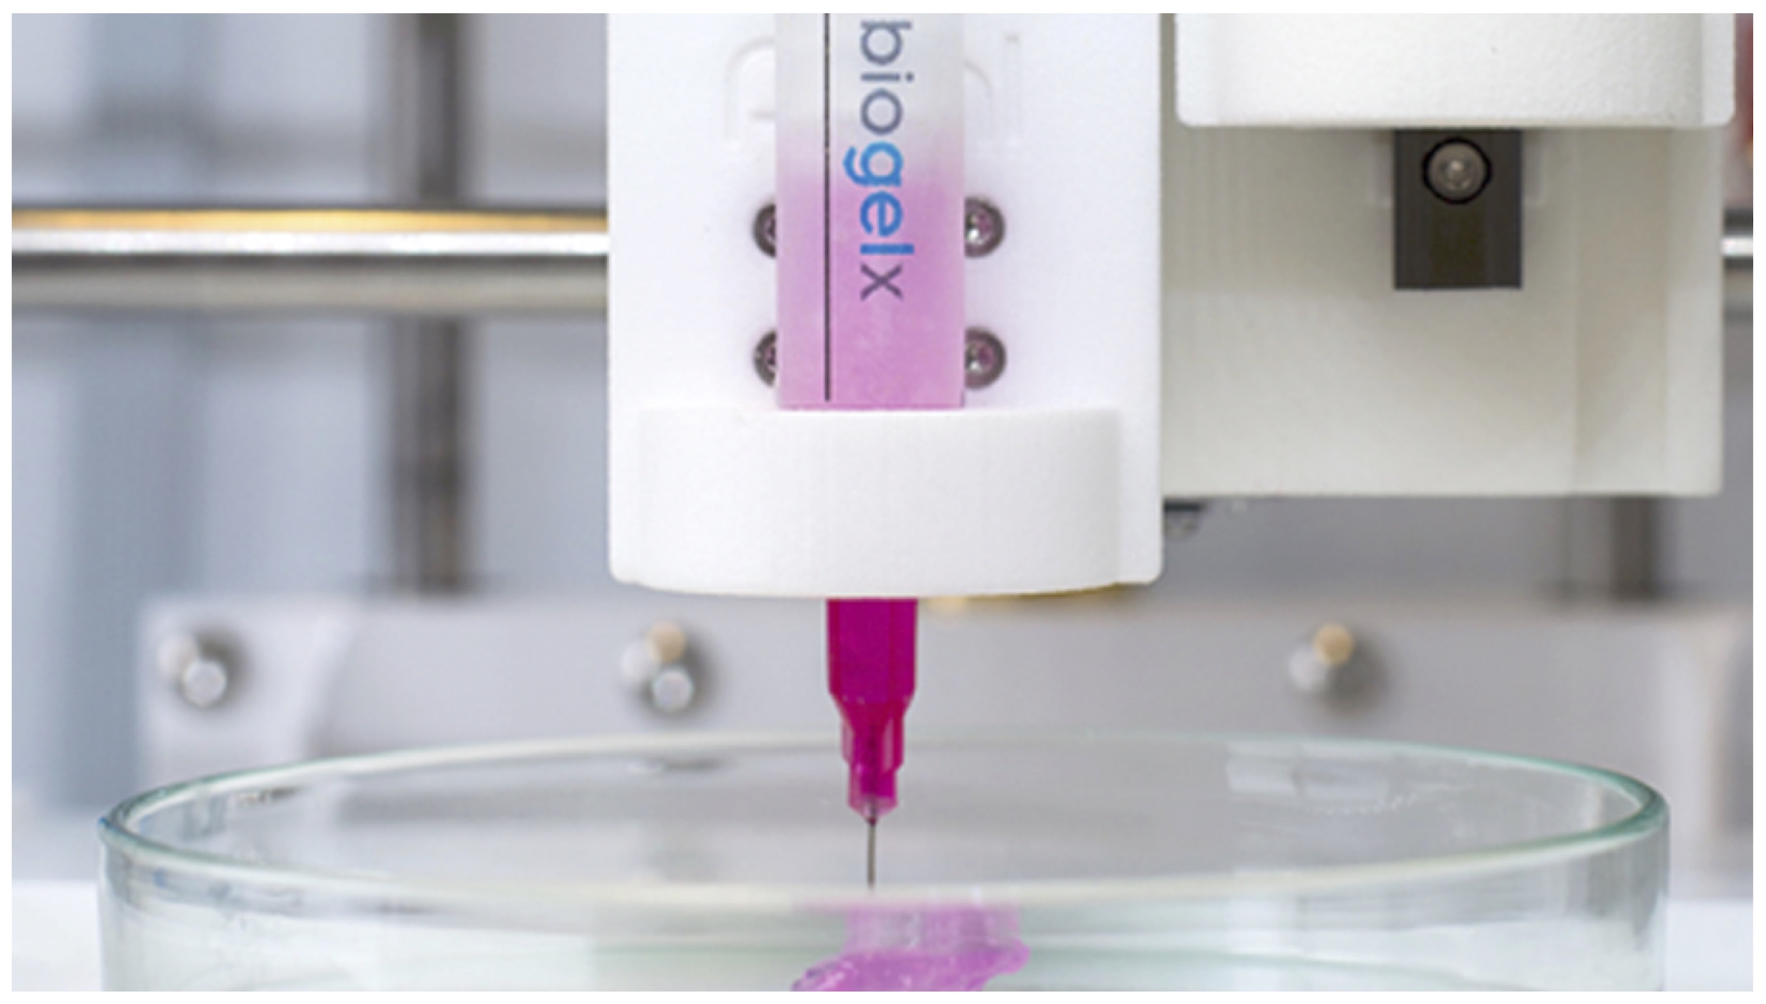
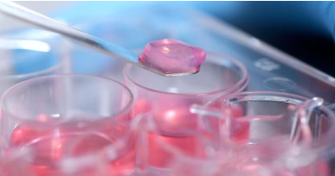
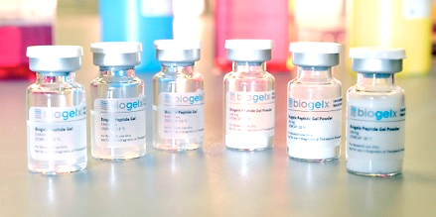
Institution description
Biogelx
Biomaterials SME – design and supply a range of hydrogels and bioinks
Spin-out from University of Strathclyde in 2013
HQ at Biocity, near Glasgow, Scotland
Currently 11 employees (4 PhD Scientists)
Offering leading expertise in the development, formulation and manufacture of tuneable chemically-defined peptide hydrogels and bioinks for 3D cell culture and bioprinting applications.

Slide 3
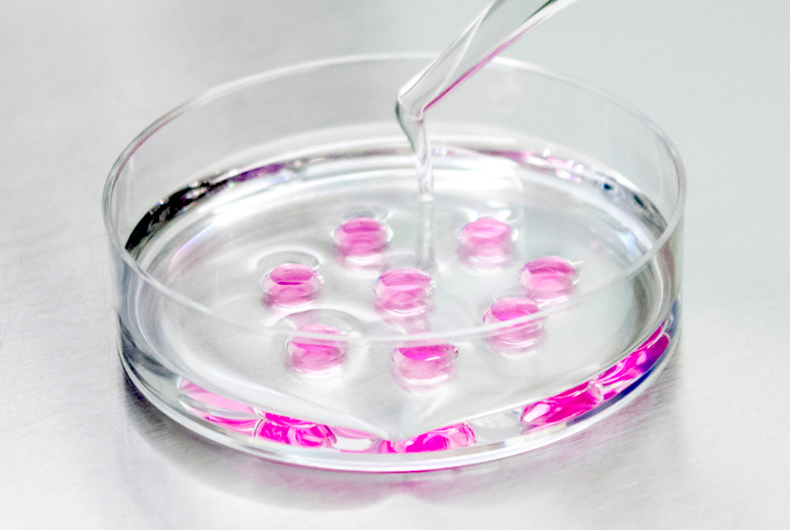
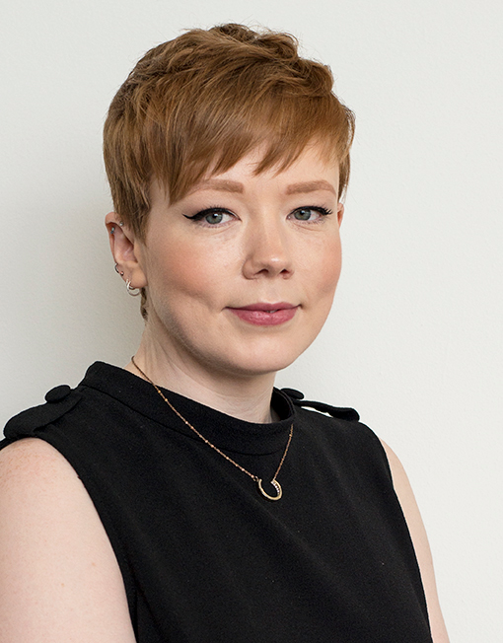
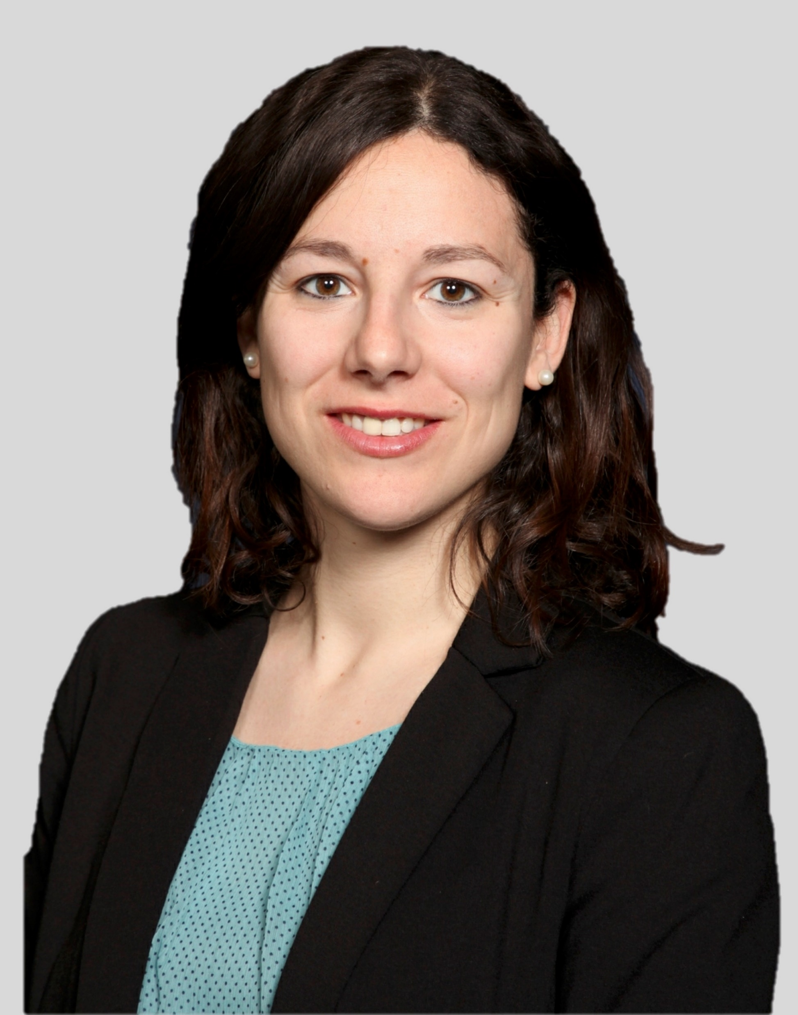
Research group
Research
Hydrogels for more physiologically relevant 3D cancer models
Biogelx has designed functionalized gels that provide appropriate extracellular matrix (ECM) components in a 3D configuration with controllable mechanical properties. The possibility of utilizing our hydrogels to mimic both healthy and cancerous tissue environments could provide a valuable tool for drug discovery.
THERACAT team
Dr. Laura Goldie (PI)
Dr. Elia Lopez-Bernardo
Africa Galvez Flores (ESR9)
Contract start: 14/01/19
Contract end: 12/01/22

Slide 4
Role within the network
Research
WP5: In vitro delivery and imaging
Task 5.1: Synthesis catalysts carriers bearing targeting ligands (TUE, BAS, BGX).
Task 5.3: Test the efficiency of prodrug conversion in 2D and 3D cancer models (BGX, TUE, BAS, IBEC).
Started- Initial experiments looking at culture of MCF-7 cancer cells on Biogelx hydrogels underway.
D5.3 : Selection of the best catalyst in vitro. Delivery Month 36
MS19 : Toxicity and delivery screening in a 3D cancer model. Month 36
WP6: In vivo evaluation
Task 6.3 - Use intravital optical and PET imaging to study catalyst localization and efficacy (BGX, TUE, BAS, IBEC).

Slide 5
Role within the network
Training Activities
Providing technical training on hydrogels for 3D cell-based models and knowledge on the start-up and spinoff system, entrepreneurship and career development in industries and SMEs
Secondments at BGX:
ESR7 - IBEC. Month 21 – 23 (3 months)
ESR8 - TUE. Month 36 – 38 (3 months)
ESR11 - EDI. Month 21 – 23 (3 months)
Training Events:
TE5 – Getting ready for the next career step. Month 36
Career opportunities in industry and interview simulations
Member of Assessment Commission 3 (BAS, IBEC, BGX, TAU-a)
Fellows: ESR3, ESR8, ESR11, ESR12, ESR13

