Slide 1
Bio-ortogonal catalysis for cancer therapy
TEVA Presentation
Mid-Term Check Meeting
Edinburgh, 5th June 2019
Teva Pharmaceutical Industries LTD

Slide 2
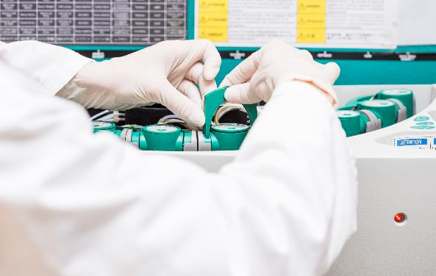
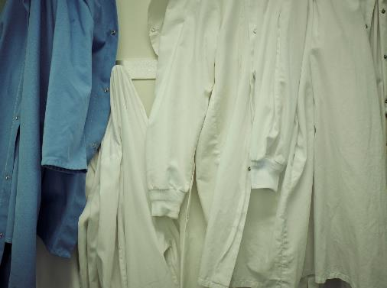
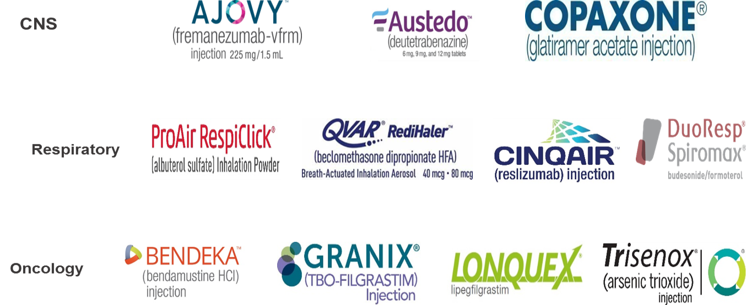
Teva Leading Generic Medicines
1000+
Launches in 2017
1 in 7
Rx in the US
Top 3 position
in 25 markets
Strong Gx growth in
Japan and LatAm
550+
therapies
1800+
Molecules
#1
in first-to-files
1 in 8
Rx in the UK
Teva Leading Specialty Brands

Slide 3
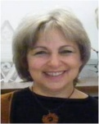
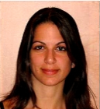
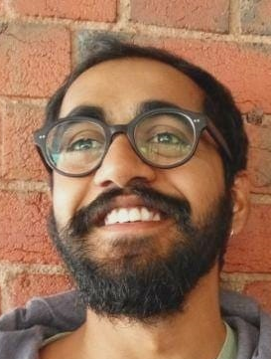
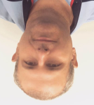
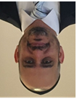
Teva Team
Principal Investigator
Bianca Avramovitch, PhD
Teva Coordinator,
Academic Affairs and Networks
Tal Yoetz, PhD
Analytical Technologies Specialist
Yousif Ayoub, PhD
Formulation Specialists
Aviram Spernath, PhD
Tamar Gordon, PhD
Macro Molecules Specialist
Krishna Vippala
ESR3 Fellow
Turi Komlosh, PhD
CMC Development Specialist
(chemistry & manufacturing controls)
Tal Hasson, PhD
Chemistry Specialist
Sharon Gazal, PhD

Slide 4
Role within the network
ESR3: Oral nano delivery – Formulation design and characterization
Research
Synthesize enzyme-responsive hydrophobic dendrons according to procedures developed by Prof. Amir (TAU) and to modify it to target the specific indication
Develop high resolving methods for characterizing the species developed in collaboration with TAU and any other interested consortium partners.
Develop methods which should monitor the processes involved and researched
Evaluate the new species in biological systems.
Development of lipid/polymer-based nano formulation in lab scale
Extensive physicochemical characterization of the NPs
NPs GMP Manufacturing in larger scale (scale-up) – depending on the previous steps success

Slide 5
Role within the network
Planned secondments and trainings:
At Teva :
ESR 4 – TUE – industrial formulation of SCPN (M30, 3 months)
ESR 10 – BAS - encapsulate catalyst in lipid NP (M36, 3 months)
ESR 13 – TAU (Satchi Fainaro) – oral formulations (M36, 3 months)
ESR 3 - TEVA.
At IBEC: NP imaging (Month 18 – 21, 4 months)
At TUE – SAXS characterization of NP (Month 30, 3months)
Planned Trainings: Sept 26, 2019, Basel

