Slide 1
Bio-ortogonal catalysis for cancer therapy
UniBas Presentation
Johannes Rebelein
in representation of Thomas R. Ward
https://www.chemie.unibas.ch/~ward
Mid-Term Check Meeting
Edinburgh, 5th June 2019

Slide 2
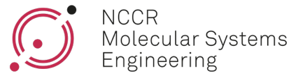
Institution description
The Basel Hub is the World’s Headquarter of Life Sciences:
  Companies: Roche, Novartis, Actelion, Lonza, Syngenta, etc…
  Research Institutes: University of Basel, ETHZ D-BSSE, FMI, Swiss-TPH
Department of Chemistry has a heavy focus on Life Sciences and Nanotechnology (15 mio CHF/year external funding); exceptional infrastructure
Leading House of a National Centre of Competence in Research “Molecular Systems Engineering” (joint with the Bio-Systems Science Engineering Dpt. of the ETHZ D-BSSE, Thomas Ward is director of the NCCR Molecular Systems Engineering))
Ward Group: 20 coworkers (8 postdocs).

Slide 3
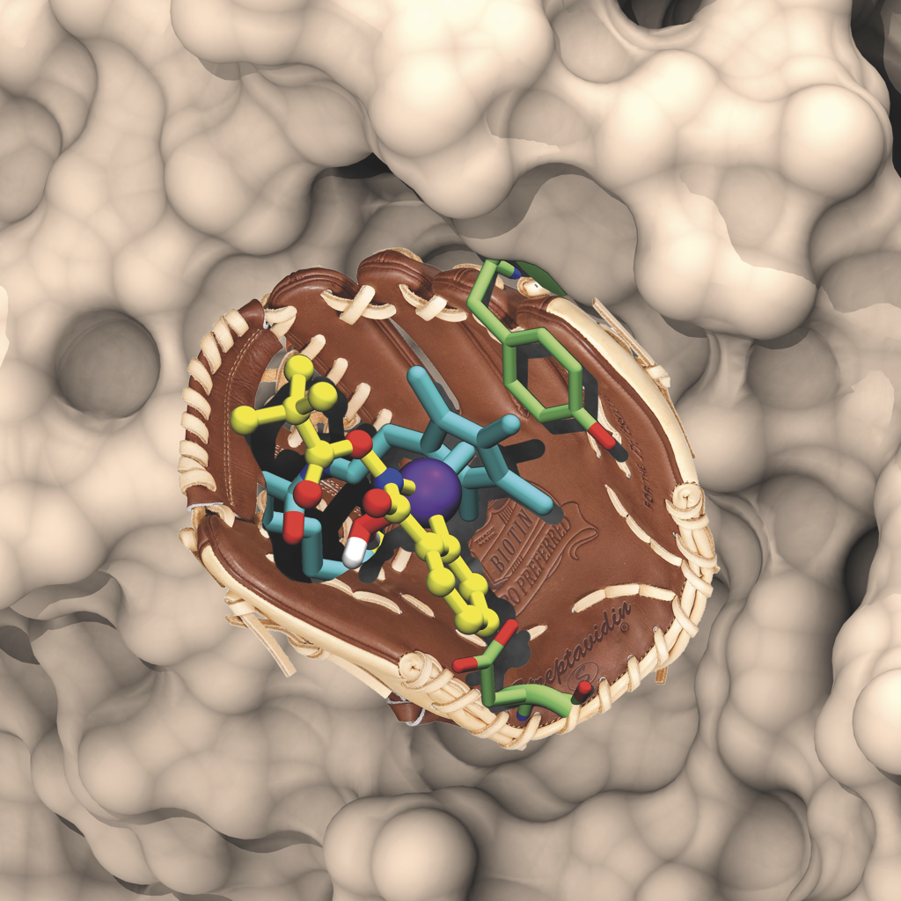
The Ward group
The Ward group focuses on Artificial Metalloenzymes
Target a synthetic metal catalyst to a protein scaffold
The cofactor catalyzes the uncaging of a protected drug
Multiple turnovers of the immobilized cofactor allow to selectively increase the drug concentration at the tumor tissue
Currently, we focus on human Carbonic Anhydrase IX

Slide 4
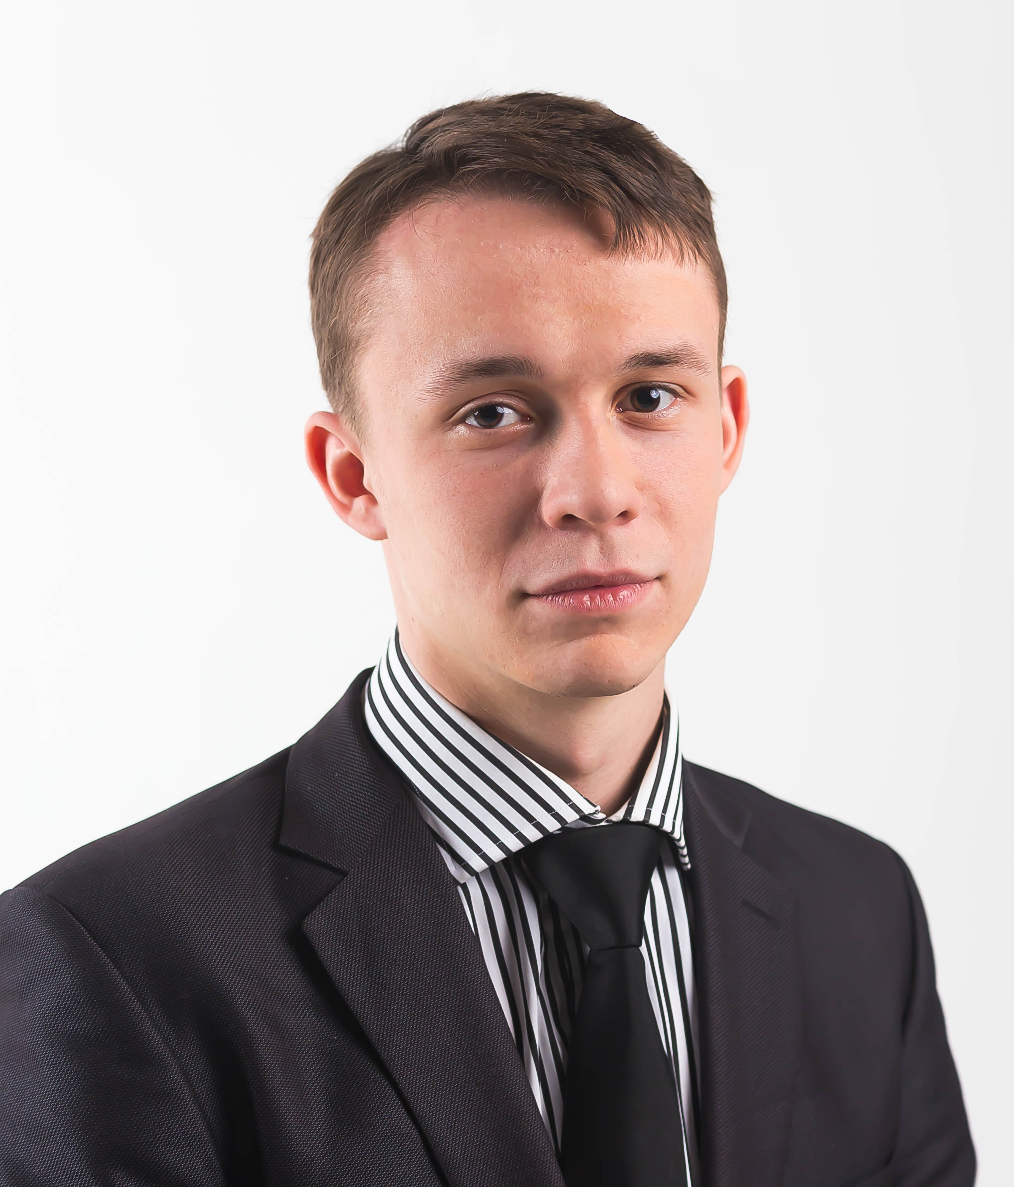
Role within the network
WP5: In vitro delivery and imaging
Task 5.1. Synthesis of catalyst carriers bearing targeting ligands (UniBas-ESR10). Underway
Task 5.3. Test the efficiency of prodrug conversion in 2D and 3D cancer models ligands (UniBas-ESR10).
Deliverable 5.1 Synthesis of 5 metathesis catalysts (M. 18)
Deliverable 5.3 Reactivity profile of two caged fluorophores and one drug uncaged upon RCM (M 36)
Reactivity profile upon incorporation into hCAIX (M 36)
WP6: In vivo evaluation
Task 6.3. Use intravital optical and PET imaging to study catalyst localization and efficacy (UniBas-ESR10).
ESR10-BAS: Boris Lozhkin
Contract start date: 01/12/18
Contract end date: 30/11/21
Supervisor: Prof. Thomas R. Ward

Slide 5
Role within the network
Training Courses:
1 – Chemical synthesis & catalysis. Month 18
Secondments at UniBas:
ESR4-TUE. Month 22 – 24 (3 months)
ESR12-TAG. Month 28 – 30 (3 months)
Organisation of Network Meetings & Conference:
Meeting 2. Month 18. Basel September 2019

