Slide 1
Bio-ortogonal catalysis for cancer therapy
IBEC Presentation
Mid-Term Check Meeting
Edinburgh, 5th June 2019
Institute for Bioengineering of Catalonia
Nanoscopy for nanomedicine group

Slide 2
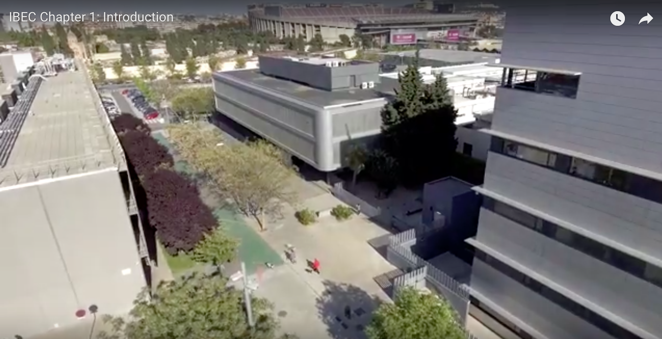
Institution description

Slide 3
Institution description

Slide 4
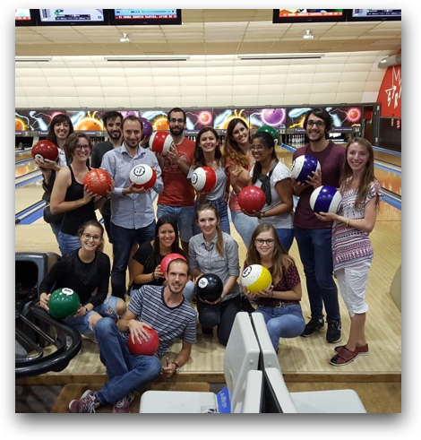
Research group

Slide 5
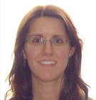
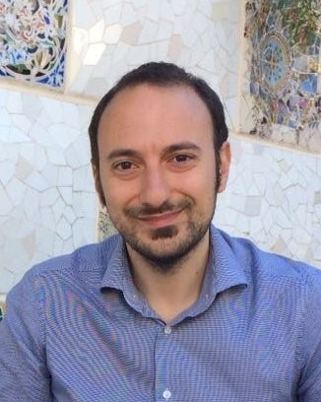
Research group
THERACAT team
ESR6-TUE: Manos Archontakis
Contract start date: 01/03/19
Contract end date: 28/02/22
Project Manager: Rosa Miralles
ESR7-IBEC: Alis Olea
Contract start date: 16/10/18
Contract end date: 15/10/21
Coordinator and supervisor: Lorenzo Albertazzi

Slide 6
Role within the network
Research
WP4: Prodrugs design and synthesis
Task 4.2. Synthesis of fluorescent dyes such (rhodamines, cyanines) protected with propargyl/allyl groups (IBEC-ESR7). Started
Task 4.3. Spectroscopic (bulk) and microscopic evaluation (single molecule) study of catalysis (EDI, IBEC-ESR7).
MS7. Synthesis of the first prodye. Month 18 D4.2. Set of 2-3 fluorescent prodyes. Month 28
WP5: In vitro delivery and imaging
Task 5.2. Fluorescence and super resolution optical imaging of carriers’ interactions with cancer cells (IBEC-ESR7, TUE).
Task 5.3. Test the efficiency of prodrug conversion in 2D and 3D cancer models (BGX, TUE, BAS, IBEC-ESR7).
MS10. Establishments of the protocol for super resolution imaging in cells. Month 18
D5.2. Description of the structure-activity relations of the material-cell interactions. Month 30
WP6: In vivo evaluation
Task 6.3. Use intravital optical and PET imaging to study catalyst localization and efficacy (BGX, TUE, BAS, IBEC-ESR7).

Slide 7
Role within the network
Training Events
TE1 – Introducing the THERACAT Network & How to plan and start a PhD. COMPLETED – March 25-29,2019
General introduction & introduction of the training programme
Skills to start a successful PhD
TE3 – Drug delivery & microscopy. Month 24
The power of microscopy techniques in biomedical research: principles and challenges
TE5 – Getting ready for the next career step. Month 36
Searching for post-doc and setting the path for academic careers
Secondments at IBEC
ESR3-TEVA. Month 18 – 21 (4 months)
ESR8-TUE. Month 21 – 24 (4 months)
ESR9-BGX. Month 36 – 39 (4 months)
ESR13-TAU (Satchi-Fainaro). Month 21 – 24 (4 months)
Member of Assessment Commission 3 (BAS, IBEC, BGX, TAU-a)
Fellows: ESR3, ESR8, ESR11, ESR12, ESR13
Organisation of Network Meetings & Conference
Kick-off Meeting. Barcelona. May 31st, 2018.
Meeting 3. Month 36. Barcelona. February 2021.
THERACAT conference. Month 42. Barcelona. August 2021.
Final Meeting. Month 48. Barcelona. February 2022.

